Slide 1
Text Summarization
Đào Việt Duy – 51603070
Nguyễn Duy Hàn Lâm – 196005004

Slide 2
References
https://www.analyticsvidhya.com/blog/2018/11/introduction-text-summarization-textrank-python/
https://www.analyticsvidhya.com/blog/2019/06/comprehensive-guide-text-summarization-using-deep-learning-python/
https://medium.com/sciforce/towards-automatic-text-summarization-extractive-methods-e8439cd54715
https://vi.wikipedia.org/wiki/PageRank

Slide 3

Abstractive Method

Slide 4
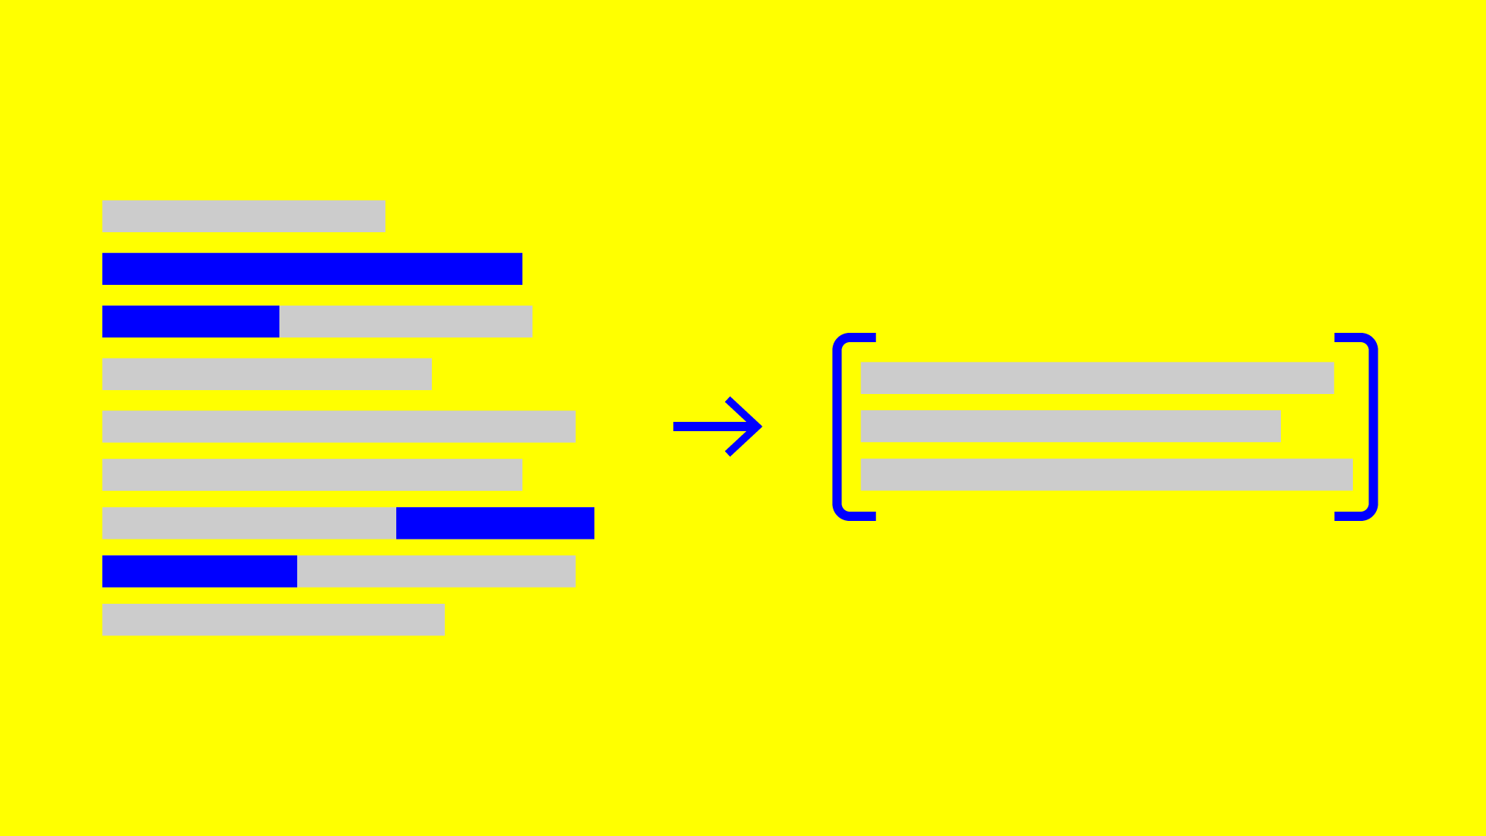
Extractive summarization text methods

Slide 5
3 method of approaches of extractive summarizations
Construction of an intermediate representation of the input text
Scoring the sentences based on the representation
Selection of a summary comprising of a number of sentences

Slide 6
Topic Representation Approaches

Slide 7
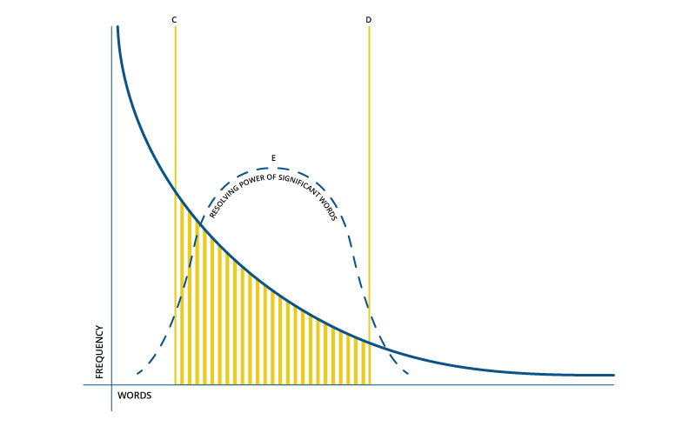
Frequency-driven approaches

Slide 8
Frequency-driven approaches
Latent Semantic Analysis
Discourse Based Method
Bayesian Topic Models

Slide 9
Indicator representation approaches
Graph Methods
Machine Learning

Slide 10
TextRank – step 1
Ex:
A programming language comprises a set of instructions. It is used to produce various kinds of output. It is a language which involves a computer performing some kind of instructions or algorithm to produce some form of output.

Slide 11
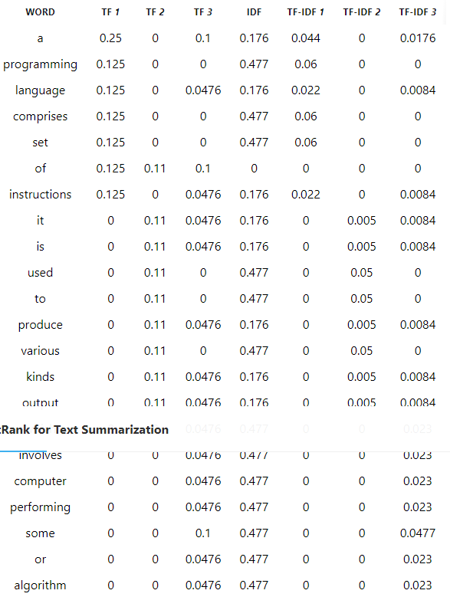
TextRank – step 2

Slide 12
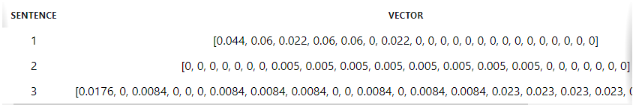
TextRank – step 2

Slide 13
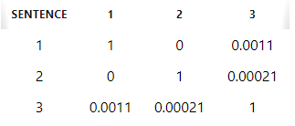
TextRank – step 3

Slide 14
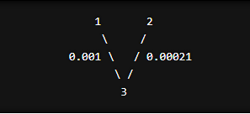
TextRank – step 4

Slide 15

PageRank

Slide 16
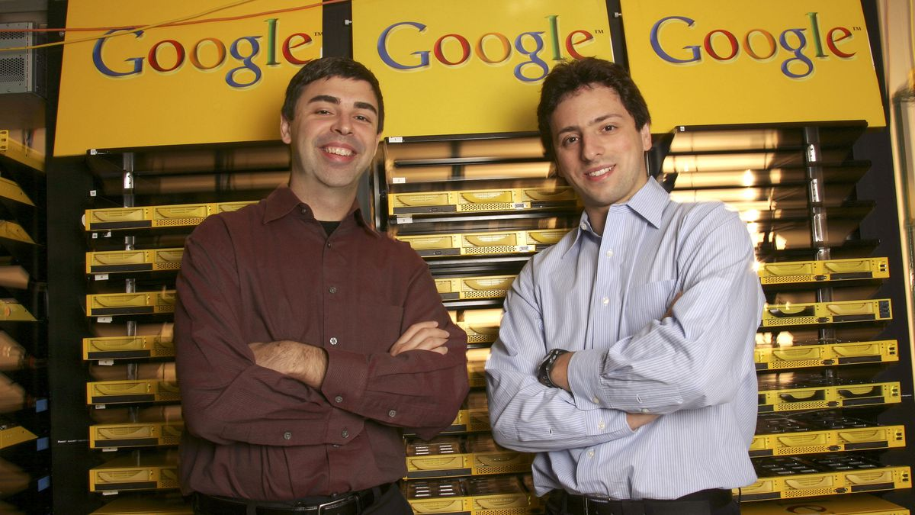
PageRank

Slide 17
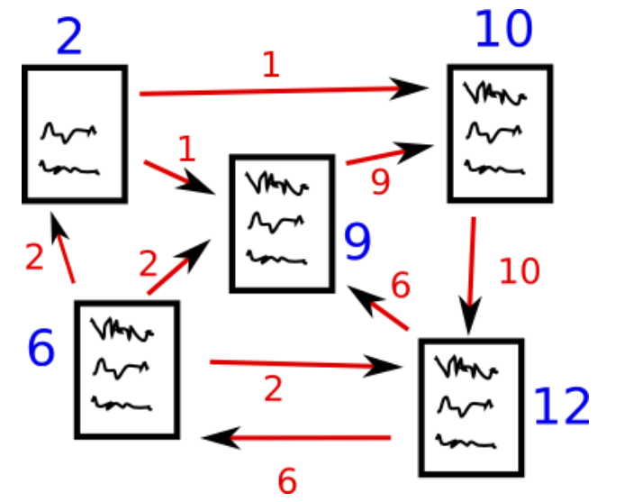
PageRank

Slide 18
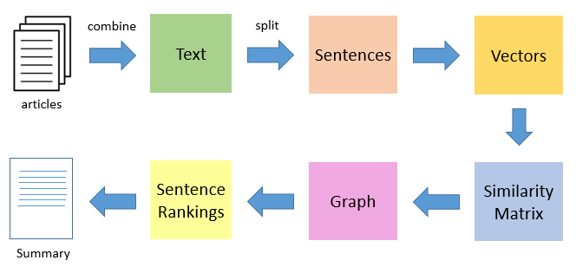
PageRank

Slide 19

PR(A) = (1 − d) + d [ PR(T1) L(T1) + ... + PR(Tn) L(Tn) ]
$\text{PR}\text{(}\text{A}\text{)}=\frac{1−d}{N}+d\sum_{a_{j}∈G\left(a_{i}\right)}{\frac{PR\left(a_{j}\right)}{PR\left(a_{j}\right)}}$

